Slide 1
Variables and Input Parameters
Variables and Input parameters in SAP HANA can be described as a type of input boxes.
It is a way of asking the reporting user for input on how to provide, present or restrict the data that will be displayed.
For course participants familiar with Business Objects terminology, the Variable is referred to as a Prompt in Business Object tools. In SAP Business Warehouse they may be referred to as variables.

Slide 2
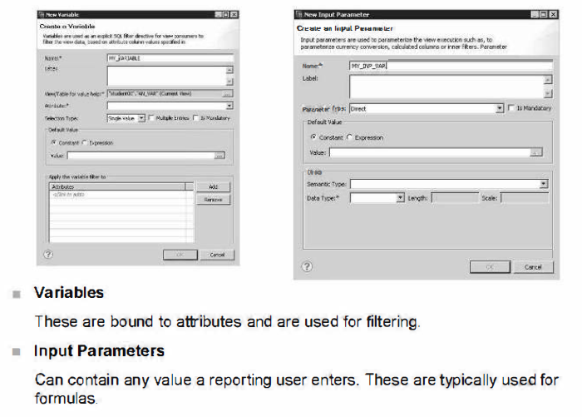

Slide 3
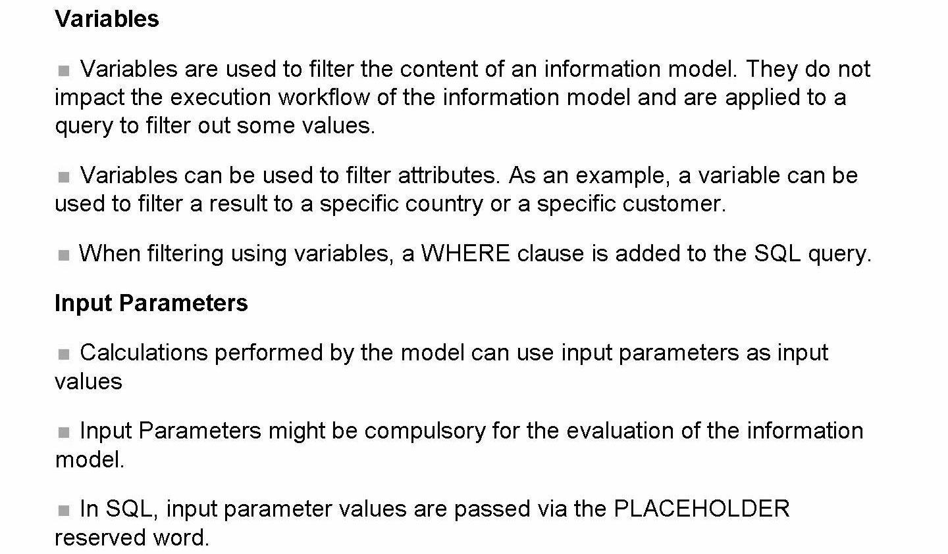
Variables compared to input parameters

Slide 4
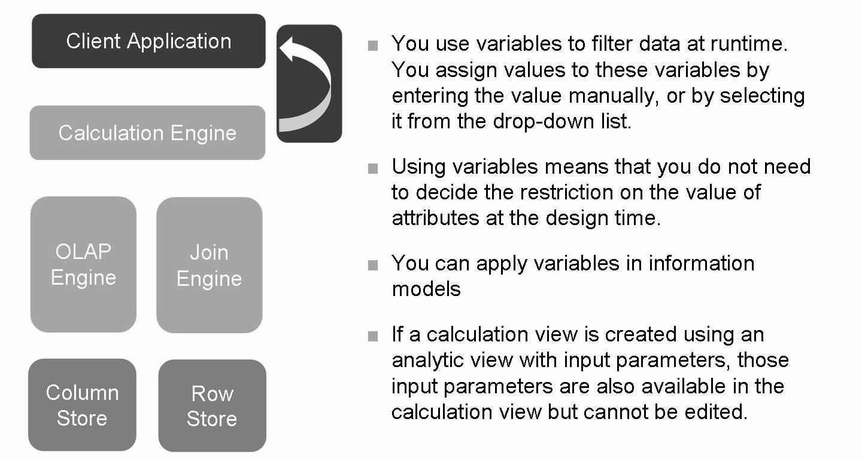
Impact of variables and input parameters

Slide 5
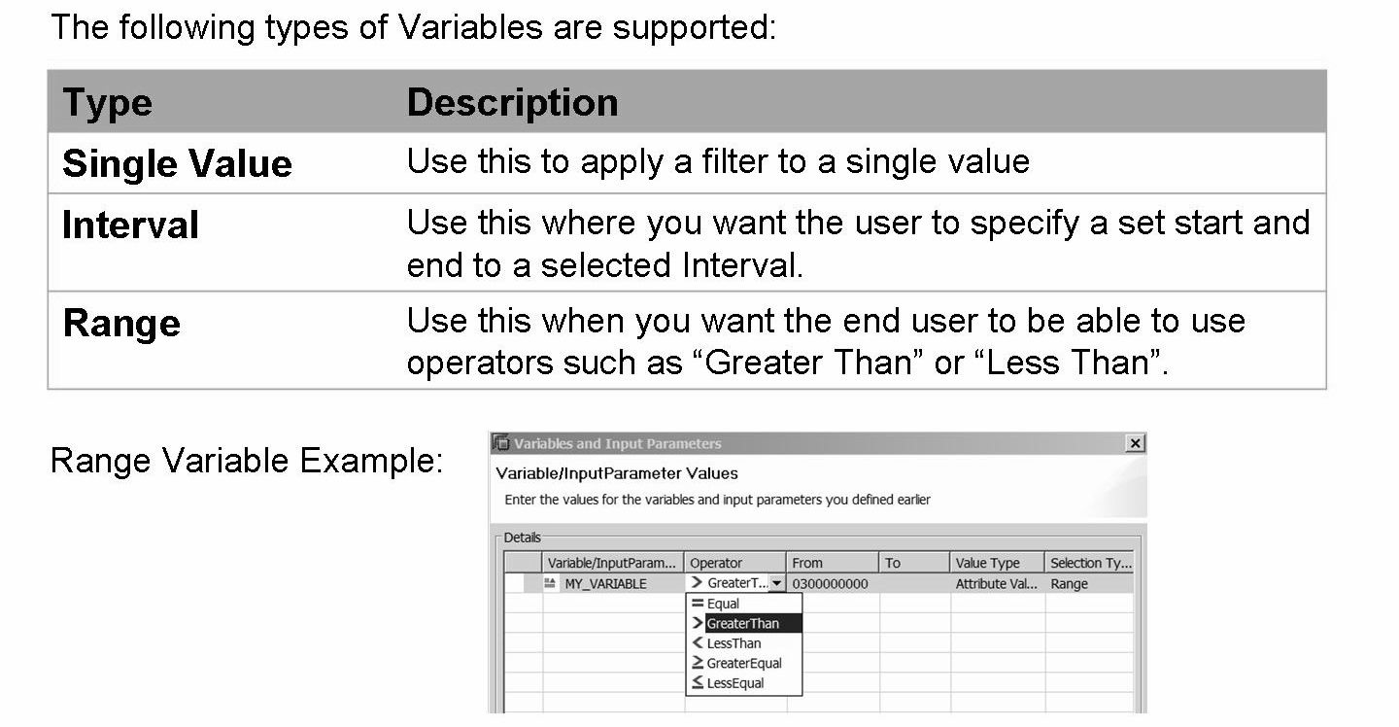
Variables Types

Slide 6
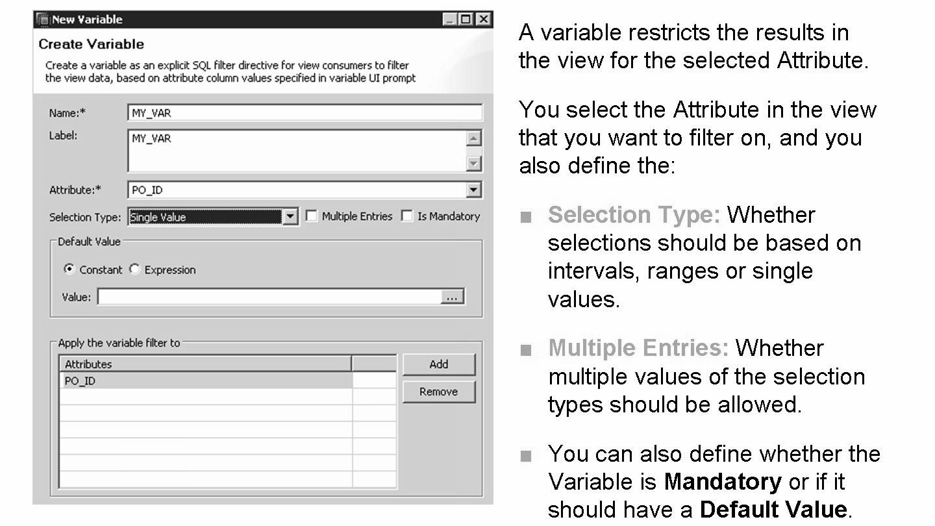
Creating Variables
One variable can filter more than one attribute.

Slide 7
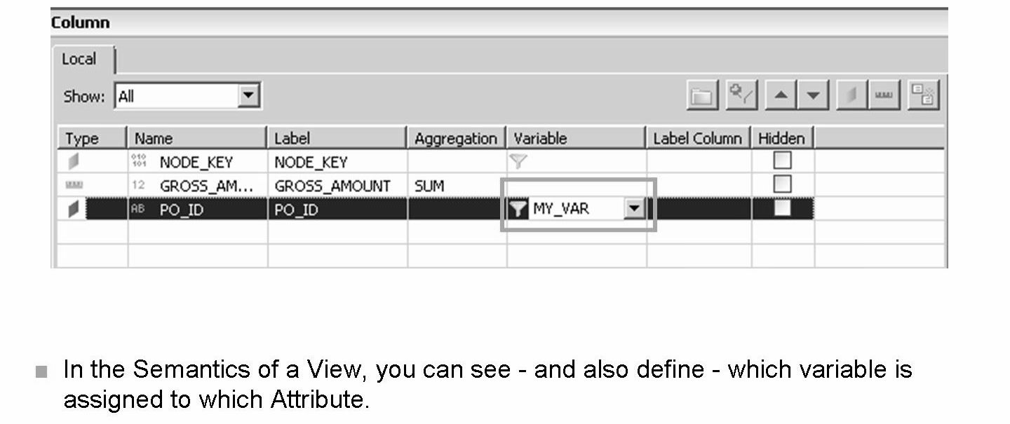
• For mandatory variables (used in calculated columns, attribute or measure type), it is mandatory to provide the value at runtime.
• For non-mandatory variables, if the values is not specified at the runtime, all data is shown without a filter when the data is previewed.
• You can see whether a variable is mandatory or not from the properties of the variable in the properties pane.
• In calculated columns, attribute or measure type, only single value variables can be used.
Note that one variable can be assigned to multiple attributes.

Slide 8
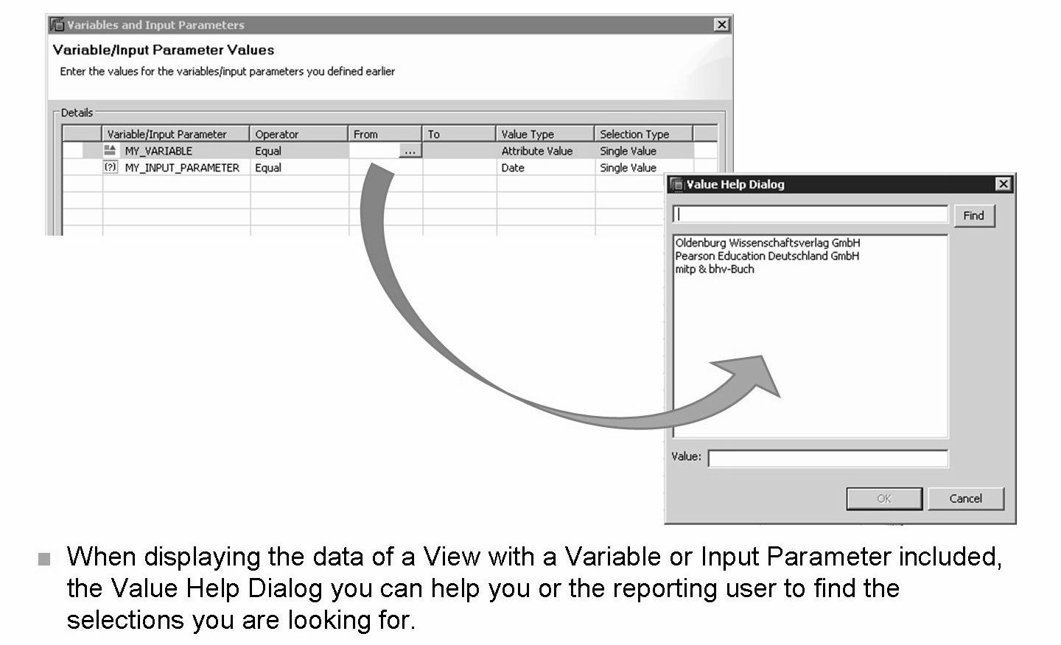
Note that more than one selection could be choose. This is possible when the “Multiple Entries” checkbox is ticked.
“From” and “To” is displayed in the “Variable Values” dialog even though you may not have defined a range.

Slide 9
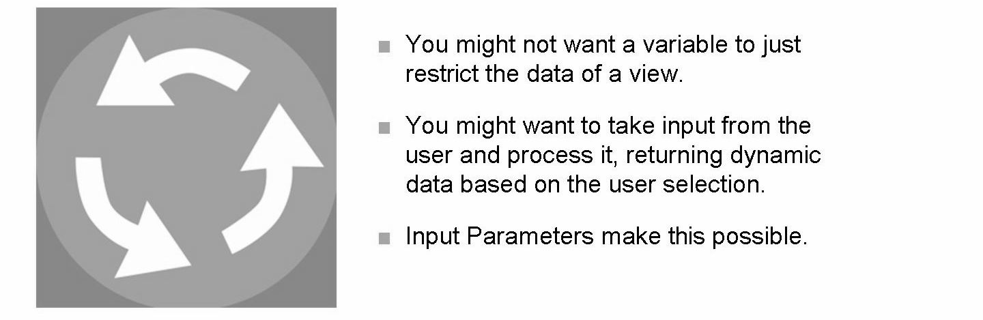
Input Parameters

Slide 10
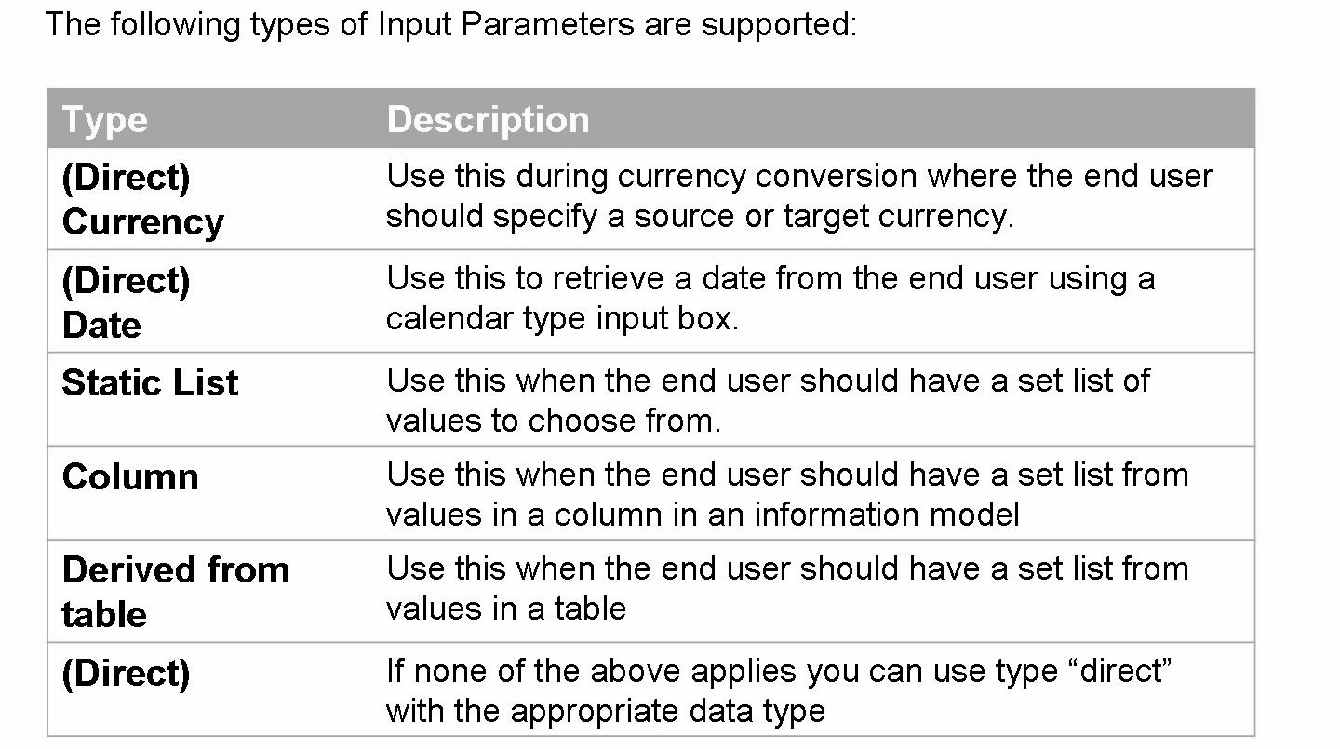
Input Parameter Types

Slide 11
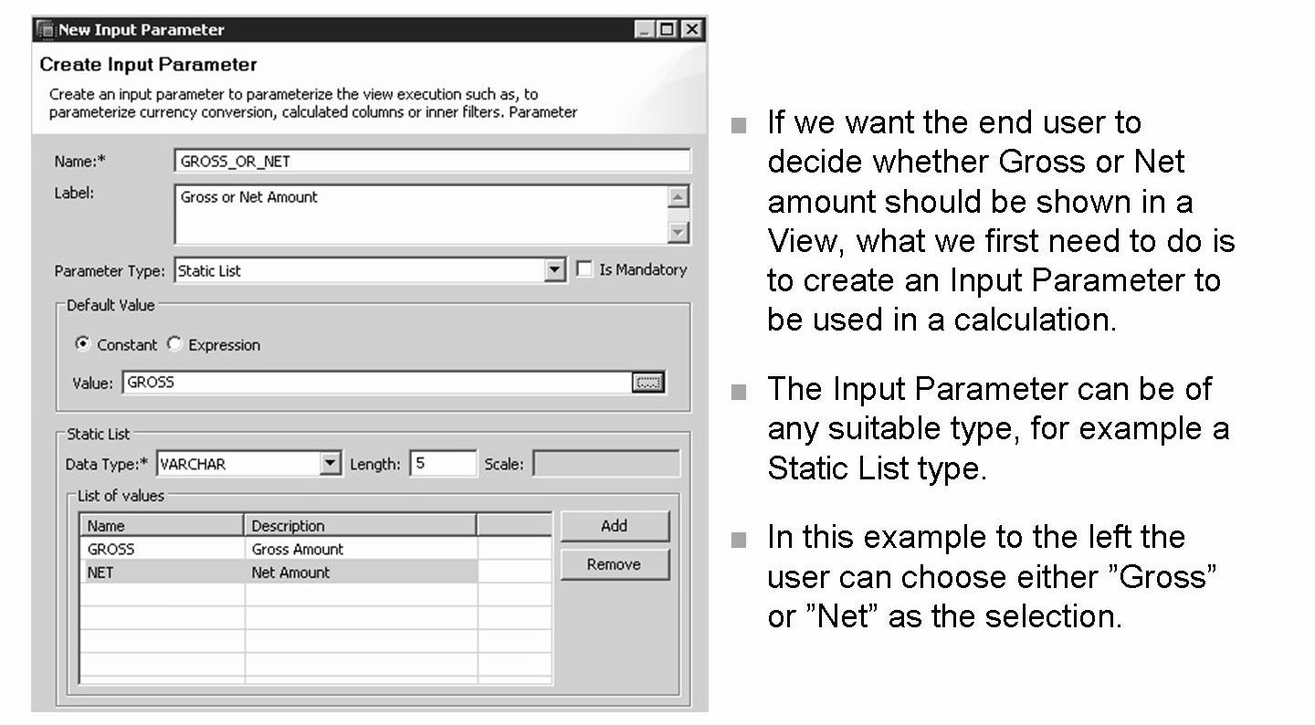
An Input Parameter to be used within a formula does not have to be a Static List type, it could also be for example a value to be used for in multiplications or any other calculations.

Slide 12
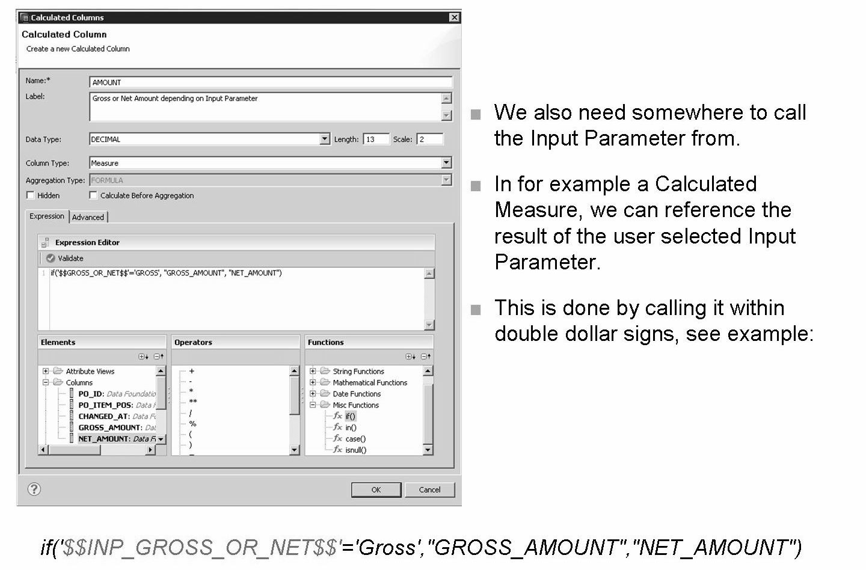
This example Calculated Column (measure type) will display the GROSS_AMOUNT measure if the user selects “GROSS”. Any other selection will result in NET_AMOUNT.

Slide 13
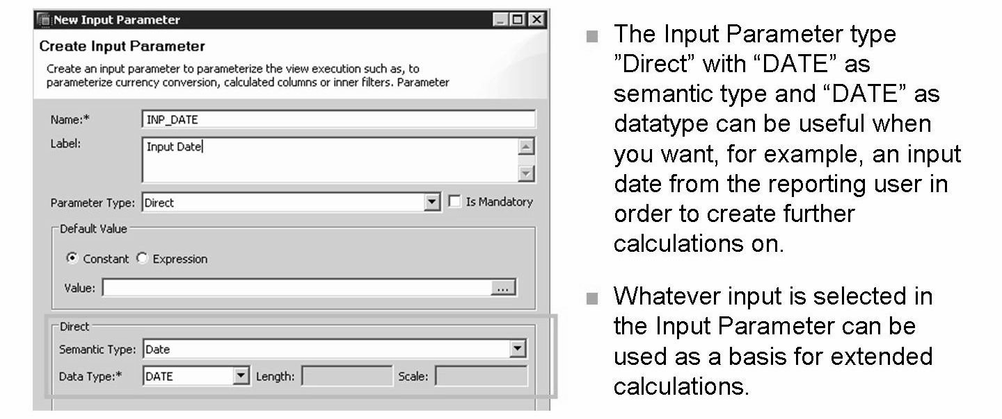
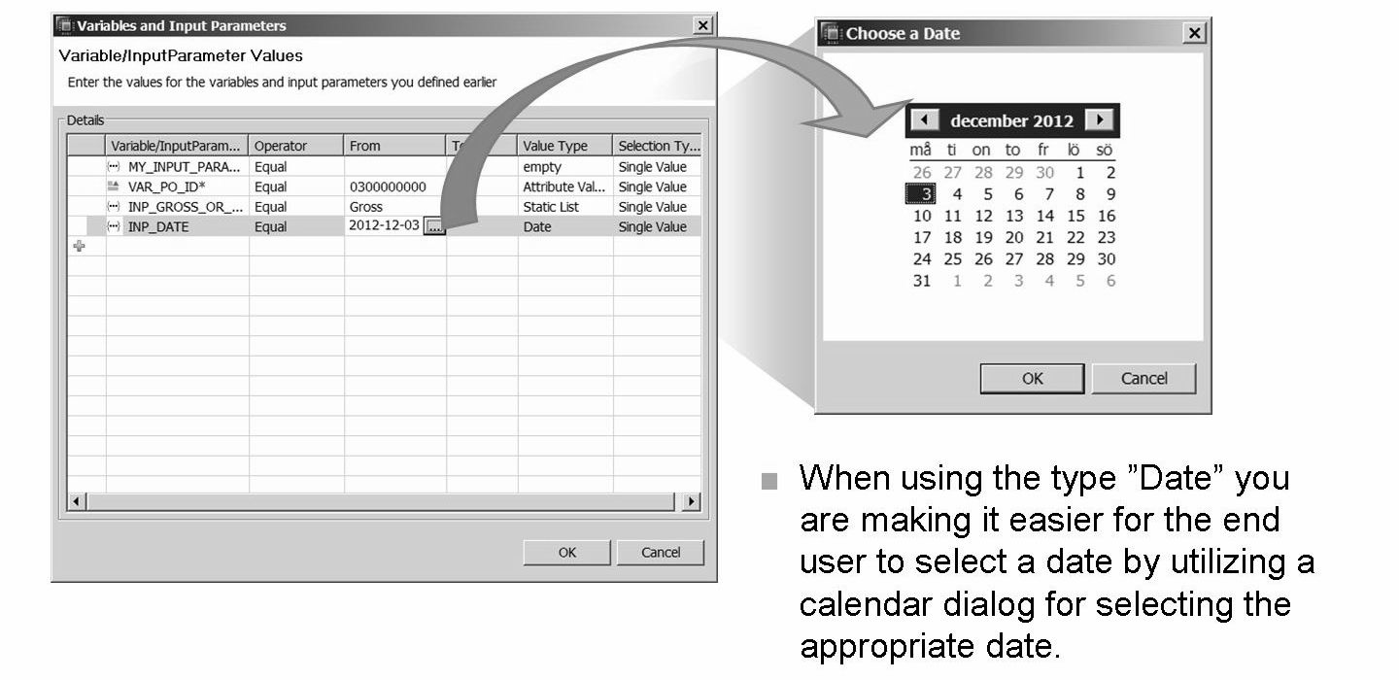
l

Slide 14
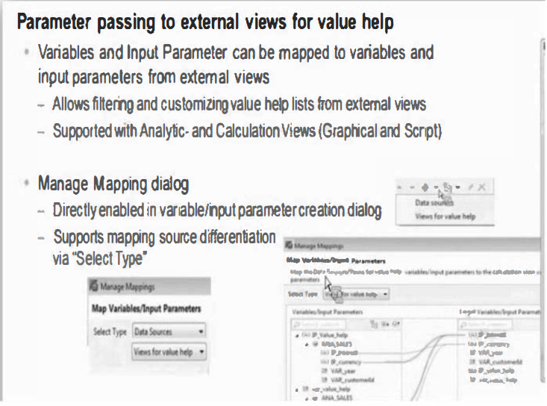

Slide 15
Counters
If you want to count the number of distinct values for one or more attribute columns, you create counters, which are special type of columns that displays the distinct count of attribute columns.
You can create counters for multiple attribute columns at a time. For example, if you create a counter for two columns, then the counter displays the count of distinct combinations of both the columns.
You can create counters for attribute columns in the default star join node or in the default aggregation view node only.

Slide 16
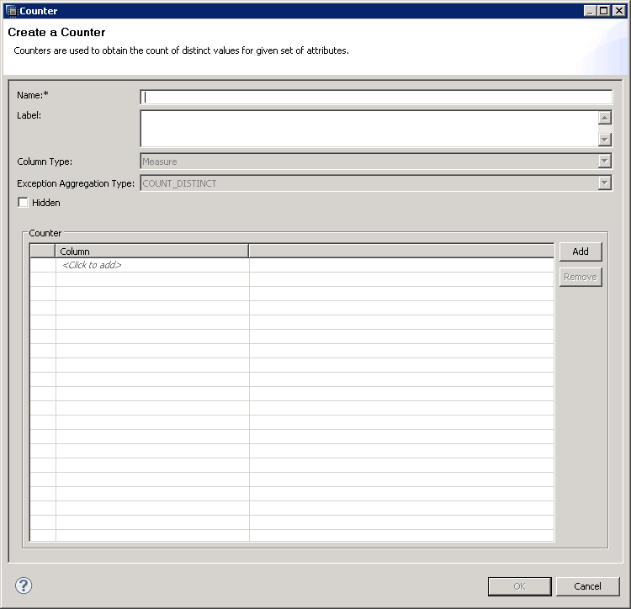
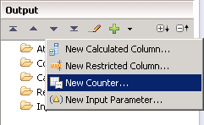

Slide 17
THANK YOU
Courtesy : SAP Labs Document -
HA 300 – SAP HANA Implementation and Modeling

